Slide 1
Introduction to C++
Dr. Alex Hill
a.d.hill@liverpool.ac.uk
October 2022

Slide 2
Last week…
Vectors, functions, data and plotting

Slide 3
AIM of workshop five
Homework recap
Classes in C++
Monte Carlo and Markov Chains

Slide 4
Resources
alex-hill94.github.io/#WS5
https://www.w3schools.com/cpp/cpp_classes.asp
https://library.lanl.gov/cgi-bin/getfile?00326866.pdf

Slide 5
Challenge eight recap
Create a class called Country with attributes:
Population, size, national language
Include a method called Greet, which outputs “Hello!”
In main(), create objects from the country class called: UK, France, Spain
Use constructors to initialise the attributes mentioned above
Print all attributes and run Greet
Bonus: inside Greet include an ‘if’ statement that changes language based on the national language

Slide 6
Challenge eight solution: ali
Else if (elif) preferable for more data-intensive applications
Good practice to include an error message if non of the if statements are true
Good use of constructors
#include <iostream>
using namespace std;
class Country {
public:
void Greet(string l) {
if (l=="English")
{cout << "Hello!" << endl;
}
if (l=="Spanish")
{cout << "Hola!" << endl;
}
if (l=="French")
{cout << "Bonjour!" << endl;
}
};
int Population;
int Size;
string National_language;
Country(int p, int s, string n) {
Population = p;
Size = s;
National_language = n;
}
};
int main() {
Country UK(67791400,242495,"English");
Country France(67897000,643801,"French");
Country Spain(47163418,505990,"Spanish");
UK.Greet(UK.National_language);
cout << "Information of the Country UK" << "\n";
cout << UK.Population << "\n";
cout << UK.Size << "\n";
cout << UK.National_language << "\n";
France.Greet(France.National_language);
cout << "Informations du Pays France" << "\n";
cout << France.Population << "\n";
cout << France.Size << "\n";
cout << France.National_language << "\n";
Spain.Greet(Spain.National_language);
cout << "Informacion del Pais Espana" << "\n";
cout << Spain.Population << "\n";
cout << Spain.Size << "\n";
cout << Spain.National_language << "\n";
return 0;
}
$ ./soln
Hello!
Information of the Country UK
67791400
242495
English
Bonjour!
Informations du Pays France
67897000
643801
French
Hola!
Informacion del Pais Espana
47163418
505990
Spanish

Slide 7
Challenge eight solution: andrea
Could you explain these?
Nice defining of method outside of class
#include <iostream>
class country
{
private:
//Set UK as default country
double population=67.33; //milions
double size=242495; //km^2
std::string language="English";
public:
country() = default;
country(double input_pop, double input_size, std::string input_lang)
{
population = input_pop;
size = input_size;
language = input_lang;
}
// Destructor
~country(){}
void greet();
void print_attributes();
};
void country::greet()
{
if (language=="Spanish") {std::cout<<"Hola!"<<std::endl;}
else if (language=="French") {std::cout<<"Salut!"<<std::endl;}
else {std::cout<<"Hello!"<<std::endl;}
}
🇬🇧
void country::print_attributes()
{
std::cout<<"Population (milion): "<<population<<std::endl;
std::cout<<"Size (square kilometres): "<<size<<std::endl;
std::cout<<"Language: "<<language<<std::endl;
}
int main(){
country UK;
country France{67.5, 543940, "French"};
country Spain{47.3, 505990, "Spanish" };
std::cout<<"UK"<<std::endl;
UK.greet();
UK.print_attributes();
std::cout<<"France"<<std::endl;
France.greet();
France.print_attributes();
std::cout<<"Spain"<<std::endl;
Spain.greet();
Spain.print_attributes();
return 0;
}
Concise
$ ./soln
UK
Hello!
Population (milion): 67.33
Size (square kilometres): 242495
Language: English
France
Salut!
Population (milion): 67.5
Size (square kilometres): 543940
Language: French
Spain
Hola!
Population (milion): 47.3
Size (square kilometres): 505990
Language: Spanish

Slide 8
Challenge eight solution: katie
int main() {
Country UK; //Create an object of Country
//Access attributes and set values
UK.population = 67300000;
UK.language = "English";
Country France; //Create an object of Country
//Access attributes and set values
France.population = 67500000;
France.language = "French";
Country Spain; //Create an object of Country
//Access attributes and set values
Spain.population = 47300000;
Spain.language = "Spanish";
//Print attribute values
UK.greet();
cout << "UK population: " << UK.population << endl;
cout << "UK national language: " << UK.language << endl;
cout << endl;
cout << "France population: " << France.population << endl;
cout << "France national language: " << France.language << endl;
cout << endl;
cout << "Spain population: " << Spain.population << endl;
cout << "Spain national language: " << Spain.language << endl;
return 0;
}
Works fine
#include <iostream>
#include <cmath>
#include <vector>
using namespace std;
class Country { //The class
public: // Access specifier
int population; //Attribute (int variable)
string language; //Attribute (string variable)
void greet(); //Method/function declaration
};
//Method/function definition outside the class
void Country::greet(){
cout << endl << "Hello!" << endl;
}
$ ./soln
Hello!
UK population: 67300000
UK national language: English
France population: 67500000
France national language: French
Spain population: 47300000
Spain national language: Spanish

Slide 9
Challenge eight solution: lauryn
Nice use of else if, but this will make Spanish the default
#include <iostream>
using namespace std;
class Country{
public:
float population;
int size;
string language;
void Hello(){
if (language == "English"){
cout << "Hello!" << endl;
}
else if (language == "French"){
cout << "Bonjour!" << endl;
}
else
{
cout << "¡Hola!" << endl;
}
}
};
int main(){
Country UK;
Country France;
Country Spain;
UK.population = 67.33;
UK.size = 243610;
UK.language = "English";
France.population = 67.5;
France.size = 543940;
France.language = "French";
Spain.population = 47.33;
Spain.size = 505990;
Spain.language = "Spanish";
cout << "UK" << endl;
UK.Hello();
cout << "Population: " << UK.population << " million" << endl;
cout << "Area: " << UK.size << " km^2" << endl;
cout << "Language: " << UK.language << endl;
cout << "\n";
cout << "France" << endl;
France.Hello();
cout << "Population: " << France.population << " million" << endl;
cout << "Area: " << France.size << " km^2" << endl;
cout << "Language: " << France.language << endl;
cout << "\n";
cout << "Spain" << endl;
Spain.Hello();
cout << "Population: " << Spain.population << " million" << endl;
cout << "Area: " << Spain.size << " km^2" << endl;
cout << "Language: " << Spain.language << endl;
return 0;
}
$ ./soln
UK
Hello!
Population: 67.33 million
Area: 243610 km^2
Language: English
France
Bonjour!
Population: 67.5 million
Area: 543940 km^2
Language: French
Spain
¡Hola!
Population: 47.33 million
Area: 505990 km^2
Language: Spanish

Slide 10
Challenge eight solution: robert
#include <iostream>
using namespace std;
class Country { // The class
public: // Access specifier
int Population; // Attribute (int variable)
float Size; // Attribute (float variable)
string National_Language; // Attribute (string variable)
void Greet(); // Method/function declaration
};
// Method/function definition outside the class
void Country::Greet() {
if (National_Language == "English"){
cout << "Hello! \n";
}
else if (National_Language == "French"){
cout << "Bonjour! \n";
}
else if (National_Language == "Spanish"){
cout << "Hola! \n";
};
};
int main() {
Country UK; // Create an object of Country called UK
UK.Population = 67330000; // Sets UK's attribute 'Population'
UK.Size = 243610.0; // Set's UK's attribute 'Size'
UK.National_Language = "English"; // Set's UK's attribute 'National_Language'
UK.Greet(); // Calls the method 'Greet'
Country France; // Create an object of Country called France
France.Population = 67500000; // Sets France's attribute 'Population'
France.Size = 543940.0; // Sets France's attribute 'Size'
France.National_Language = "French"; // Sets France's attribute 'National_Language'
France.Greet(); // Calls the method 'Greet'
Country Spain; // Create an object of Country called Spain
Spain.Population = 47330000; // Sets Spain's attribute 'Population'
Spain.Size = 505990.0; // Sets Spain's attribute 'Size'
Spain.National_Language = "Spanish"; // Sets Spain's attribute 'National_Language'
Spain.Greet(); // Calls the method 'Greet'
cout << "UK's Population: " << UK.Population << "\n";
cout << "UK's Size (km^2): " << UK.Size << "\n";
cout << "UK's National Language: " << UK.National_Language << "\n \n”;
…
Nice job, but no exception if the languages aren’t of these three
$ ./soln
Hello!
Bonjour!
Hola!
UK's Population: 67330000
UK's Size (km^2): 243610
UK's National Language: English
France's Population: 67500000
France's Size (km^2): 543940
France's National Language: French
Spain's Population: 47330000
Spain's Size (km^2): 505990
Spain's National Language: Spanish

Slide 11
Challenge eight solution: tom
Good use of constructors
Good if chain
#include <iostream>
using namespace std;
class Country {
public:
int population;
double size;
string language;
Country(int x, double y, string z){
population = x;
size = y;
language = z;
}
void Greet(){
if(language == "German" || language == "german"){cout << "Hallo";}
else if(language == "French" || language == "french"){cout << "Bonjour";}
else if(language == "Italian" || language =="italian"){cout << "Ciao";}
else{cout << "Sorry, country language not recognised";}
}
};
int main(){
Country Germany(83130000, 357588, "German");
Country France(67500000, 543940, "French");
Country Italy(59070000, 301230, "Italian");
cout << "German Population: " << Germany.population << "\nGermany Size: " << Germany.size << " km^2\nGerman Greeting: ";
Germany.Greet();
cout << "\n\nFrench Population: " << France.population << "\nFrance Size: " << France.size << " km^2\nFrench Greeting: ";
France.Greet();
cout << "\n\nItalian Population " << Italy.population << "\nItaly Size: " << Italy.size << " km^2\nItalian Greeting: ";
Italy.Greet();
cout << "\n\n";
return 0;
}
$ ./soln
German Population: 83130000
Germany Size: 357588 km^2
German Greeting: Hallo
French Population: 67500000
France Size: 543940 km^2
French Greeting: Bonjour
Italian Population 59070000
Italy Size: 301230 km^2

Slide 12
Challenge nine
Download https://alex-hill94.github.io/Workshop/Intro_to_C++/soln.cpp
Adapt this script so that the write_out function is replaced with a class
Use the constructor to create the data.py file, and use a method within the class to save the vectors

Slide 13

classes
Basics of Classes in C++
Attributes and Methods
Constructors
Access specifiers

Slide 14

Object oriented programming
Procedural programming writes functions to perform operations on data
OOP creates objects that contain both data and functions
Why? DRY! (Don’t repeat yourself)

Slide 15




Classes and objects
A ‘Class’ is a template for an ‘Object’
An ‘Object’ is an instance of a Class
E.g. for the ’Car’ class, you may have ‘Volvo’, ‘Audi’ and ‘Ford’ objects

Slide 16
Classes and objects
Classes have attributes (variables, e.g. weight, colour)
Classes have methods (functions, e.g. brake, open door)
Attributes and functions are referred to as class members
Attributes
Methods

Slide 17
Classes: attributes
Creates a class called Car
Determines how visible innards of class is to the outside
#include <iostream>
using namespace std;
class Car { // The class
public: // Access specifier
int n_seats; // Attribute (int variable)
string brand; // Attribute (string variable)
string model; // Attribute (string variable)
};
int main() {
Car newcar; // Create an object of Car
// Access attributes and set values
newcar.n_seats = 5;
newcar.brand = "Seat";
newcar.model = "Ibiza";
// Print attribute values
cout << newcar.n_seats << "\n";
cout << newcar.brand << "\n";
cout << newcar.model << "\n";
return 0;
}
Creates some attributes
Creates object called newcar via the car class
Changes values of class attributes

Slide 18
Classes: Attributes
int main() {
Car peoplecarrier; // Create an object of Car
Car sportscar; // Create an object of Car
// Access attributes and set values
peoplecarrier.n_seats = 7;
sportscar.n_seats = 2;
return 0;
}
You can create multiple objects of a given class

Slide 19
Classes: methods
Creates a function inside the class
#include <iostream>
using namespace std;
class Car {
public:
void Beep() {
cout << "Beep Beep" << endl;
};
int speed(int maxSpeed);
};
int Car::speed(int maxSpeed) {
return maxSpeed;
}
int main() {
Car myObj; // Create an object of Car
myObj.Beep();
cout << myObj.speed(200); // Call the method with an argument
return 0;
}
Declare a function inside the class
Define the function outside outside the function
Scope resolution operator ‘::’

Slide 20
Constructors
Constructor is called with the class name
Pass arguments to constructors when objects are created
#include <iostream>
using namespace std;
class Car { // The class
public: // Access specifier
string brand; // Attribute
Car(string x) { // Constructor with parameters
brand = x;
}
};
int main() {
// Create Car objects and call the constructor with different values
Car carObj1("BMW");
Car carObj2("Ford");
// Print values
cout << carObj1.brand << "\n";
cout << carObj2.brand << "\n";
return 0;
}
Constructors are special functions that are called whenever an object is created
Constructors can take arguments, e.g. to initialise the values of certain attributes
You can also define constructors outside of a class

Slide 21
Principles of OOP
Encapsulation
Inheritance
Polymorphism

Slide 22
Access specifiers
class Car {
public:
void Beep() {
cout << "Beep Beep" << endl;
}
Access specifiers can be:
Private: members cannot be viewed outside the class
Public: members are accessible outside the class
Protected: members cannot be accessed outside the class, however they can be accessed in inherited classes
By default, classes are private

Slide 23
Access specifiers
#include <iostream>
using namespace std;
class MyClass {
public: // Public access specifier
int x; // Public attribute
private: // Private access specifier
int y; // Private attribute
};
int main() {
MyClass myObj;
myObj.x = 25; // Allowed (public)
myObj.y = 50; // Not allowed (private)
return 0;
}
$ g++ -std=c++11 -o soln lesson_ex.cpp
lesson_ex.cpp:14:9: error: 'y' is a private member of 'MyClass'
myObj.y = 50; // Not allowed (private)
^

Slide 24
Encapsulation
Encapsulation ensures that code and data are in a black box (if desired)
You can use the ‘private’ access specifier to ensure this
It’s often the practice to use functions to retrieve (get) and define (set) attributes
Code
Data

Slide 25
Encapsulation
#include <iostream>
using namespace std;
class Employee {
private:
int salary;
public:
void setSalary(int s) {
salary = s;
}
int getSalary() {
return salary;}};
int main() {
Employee myObj;
myObj.setSalary(50000);
cout << myObj.getSalary();
return 0;}
(base) alexhill at Alexs-Air in ~/Documents/UOL/Teaching/C++_Workshops/Workshops/WS4/Scripts
$ ./soln
50000

Slide 26
inheritance
#include <iostream>
using namespace std;
// Base class
class Vehicle {
public:
string brand = "Ford";
void honk() {
cout << "Tuut, tuut! \n" ;}};
// Derived class
class Car: public Vehicle {
public:
string model = "Mustang";};
int main() {
Car myCar;
myCar.honk();
cout << myCar.brand + " " + myCar.model;
return 0;}
You can have multilevel inheritance (Grandparent -> Parent -> Child)
Derived class inherits from parent class using ‘:’ symbol
You can also have multiple inheritance, i.e.:
class MyChildClass: public MyClass, public MyOtherClass
$ ./soln
Tuut, tuut!
Ford Mustang

Slide 27
Inheritance: access specifiers
// Base class
class Employee {
protected: // Protected access specifier
int salary;
};
// Derived class
class Programmer: public Employee {
public:
int bonus;
void setSalary(int s) {
salary = s;
}
int getSalary() {
return salary;
}
}
‘Protected’ data can be accessed by the inherited class

Slide 28
polymorphism
Polymorphism allows us to use inherited methods to perform different tasks
#include <iostream>
using namespace std;
// Base class
class Animal {
public:
void animalSound() {
cout << "The animal makes a sound \n";
}
};
// Derived class
class Pig : public Animal {
public:
void animalSound() {
cout << "The pig says: weeee\n";
}
};
// Derived class
class Dog : public Animal {
public:
void animalSound() {
cout << "The dog says: woof \n";
}
};
int main() {
Animal myAnimal;
Pig myPig;
Dog myDog;
myAnimal.animalSound();
myPig.animalSound();
myDog.animalSound();
return 0;
}
$ ./soln
The animal makes a sound
The pig says: weee
The dog says: woof

Slide 29
Monte carlo methods
History, general concepts
Quick example
Other examples
Markov Chains

Slide 30
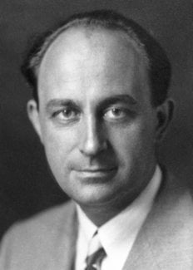
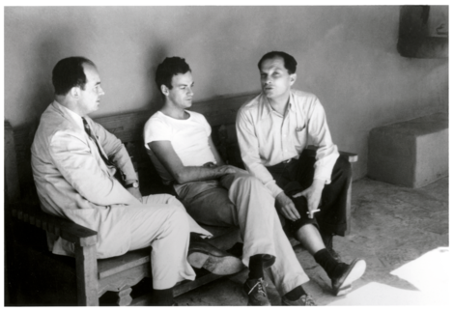
Monte carlo history
Enrico Fermi
John von Neumann
Stanislaw Ulam
The Monte Carlo Method is a mathematical technique used to estimate the outcomes of an uncertain event
Developed during WWII in relation to the Manhattan project
Named after the Monte Carlo Casino, frequented by Ulam’s uncle, as chance is important to the modelling approach
Idea: use random sampling of inputs to explore outputs complex systems

Slide 31

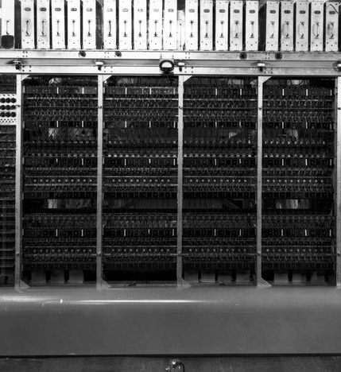

Monte carlo history
The challenge of constructing the atom bomb involved neutron diffusion
Too challenging to be addressed analytically, needed a numerical approach
Some of the first computers tried an exhaustive numerical approach (plug in many numbers into the eqn and calc the result), but this was too slow due to high dimensionality of the problem
Monte Carlo methods were found to be remarkably successful
MANIAC Computer

Slide 32

Monte carlo experiments
Generate random inputs according to some distribution
Use these to conduct an experiment
Analyse the output using statistics and make predictions of the simulation’s properties

Slide 33
Monte carlo simulations now
Building models to predict outcomes of simulations/processes given uncertain inputs
Example: roll two dice to predict probability of getting a given number in total

Slide 34

Monte Carlo examples
Business applications:
Estimate probability of cost overrun in large projects
Estimate likelihood of an asset gaining/losing value
Path tracing in video games (trace random samples of possible light paths)
AI for video games (tree search for next best move)
Computational physics, physical chemistry
E.g. Monte Carlo molecular modelling: generate states according to a Boltzmann distribution

Slide 35

Generating random numbers in c++
We’ll use the <random> header to generate random numbers (https://cplusplus.com/reference/random/)
This uses Generators and Distributions to generate random numbers
Generator: an object that generates uniformly distributed numbers
Distribution: an object that transforms sequences of numbers generated by a generator into sequences of numbers that follow a specific random variable distribution

Slide 36
Generating random numbers in c++
Mersenne twister random number engine
Start and end points
#include <iostream>
#include <vector>
#include <random>
using namespace std;
int main(){
const int range_from = 0;
const int range_to = 1000;
random_device rand_dev;
mt19937 generator(rand_dev());
uniform_int_distribution<int> distr(range_from, range_to);
cout << distr(generator) << '\n';
return 0;
}
random_device: creates non-deterministic random numbers
Uniform integer distribution
Define distribution
Distribution takes Generator as argument to produce random number

Slide 37
Example
#include <iostream>
#include <vector>
#include <random>
#include <cmath>
#include <fstream>
#include "funcs.h"
using namespace std;
int main(){
int n_sim_runs = 1e5;
vector<double> inputs(n_sim_runs);
vector<double> outputs;
string fname = "data.py";
string xname = "x_range";
string yname = ”y_range";
for (auto i = 0; i < inputs.size(); ++i){
rnum(inputs.at(i));
}
simulation(inputs, outputs);
write_out_vec(fname, xname, inputs);
write_out_vec(fname, yname, outputs, false);
system("ipython test.py &");
return 0;
}
Some auxiliary functions I’ve made
Create inputs with length ‘n’
A ‘simulation’ takes one input (uniform dist.) and produces one output
What is the output distribution?
Blank outputs
Replaces inputs elements with random numbers
Runs ‘simulation’, outputs is now the simulation’s output
Writes out data
Runs plotting python script

Slide 38
Example
void rnum(double& input){
const double range_from = -1000;
const double range_to = 1000;
random_device rand_dev;
mt19937 gen(rand_dev());
uniform_real_distribution<double> distr(range_from, range_to);
input = distr(gen);
}
Random number function takes an element the the input vector, and makes it a random float between -1000 and 1000

Slide 39
Example
Input is fixed, output can change
void buffer(const double& input, double& output){
// Computes a polynomial from a given input, modifies the output accordingly
output = pow(input, 3) - 3*pow(input, 2) + 9.2 * pow(input,1) + 4.3;
}
void simulation(const vector<double>& input, vector<double>& output)
{
// Simulation loops over inputs and modifies the output vector
double temp_val;
for (auto i: input){
buffer(i, temp_val);
output.push_back(temp_val);
}
}

Slide 40
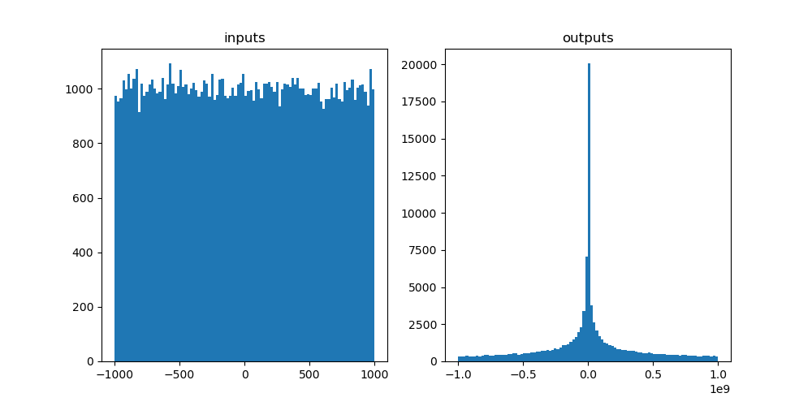
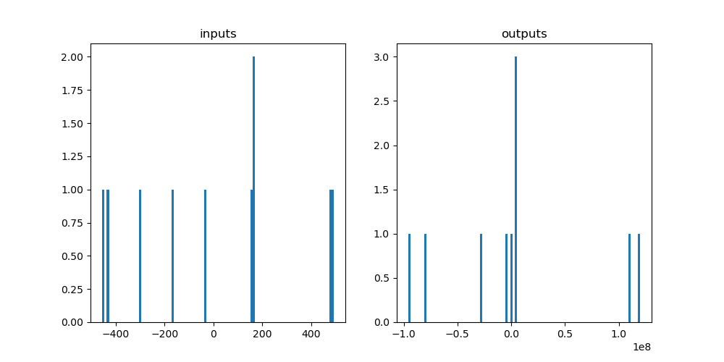
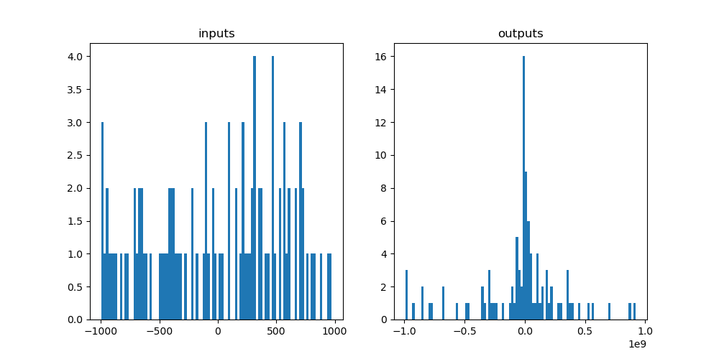
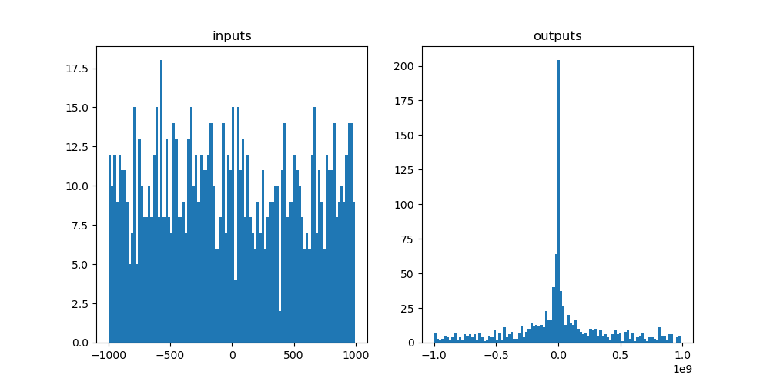
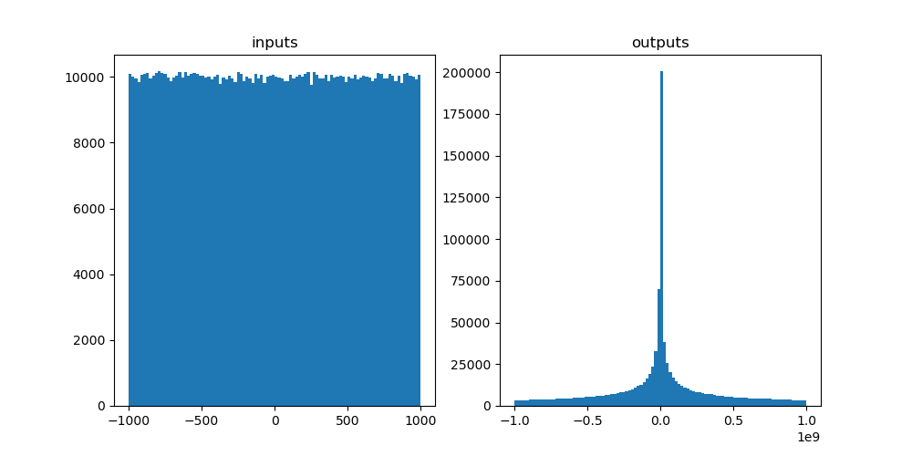
Example
1e1 -> 1e6 draws

Slide 41
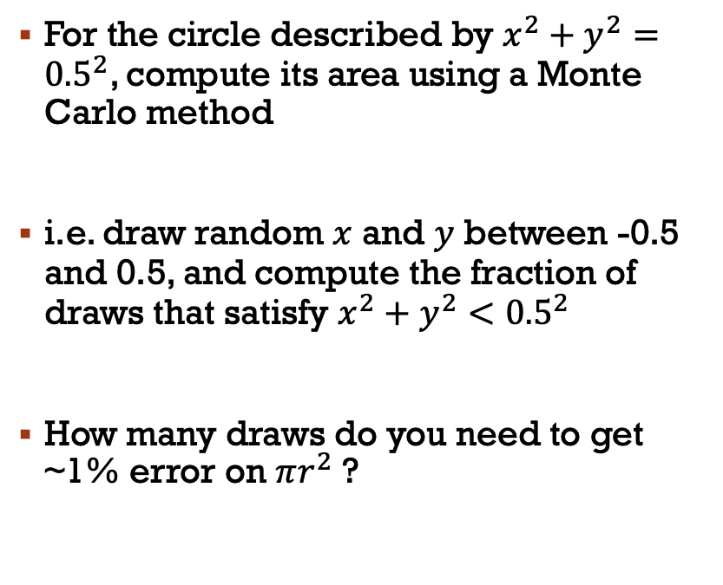
Challenge nine: Area of a circle
0.5
For the circle described by $x^{2}+y^{2}={0.5}^{2}$, compute its area using a Monte Carlo method
i.e. draw random $x$ and $y$ between -0.5 and 0.5, and compute the fraction of draws that satisfy $x^{2}+y^{2}<{0.5}^{2}$
How many draws do you need to get ~1% error on $πr^{2}$ ?
-0.5
0.5
-0.5

Slide 42
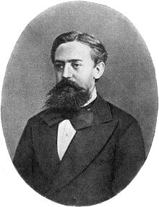
Markov chain monte carlo (MCMC)
Monte Carlo: estimate the expected value or probability density of some unknown space by drawing independent random values
For high-dimension probabilistic models, Monte Carlo sampling may not be effective, as volume of sample space grows exponentially with additional parameters
MCMCs try to sample more intelligently, the next random draw depends on the current one
Andrey Markov

Slide 43
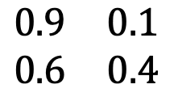
Markov chains
0.9
Attend
A simple Markov Chain uses stochastic processes to determine the evolving state of a system
Consider this system, it describes whether someone attends class given their previous attendance
E.g. if you attend class one week, there’s a 90% chance you will the next
0.1
0.6
Skip
0.4
TO
attend
skip
attend
$$\begin{matrix}0.9 & 0.1 \\ 0.6 & 0.4\end{matrix}$$
FROM
skip
Transition matrix

Slide 44
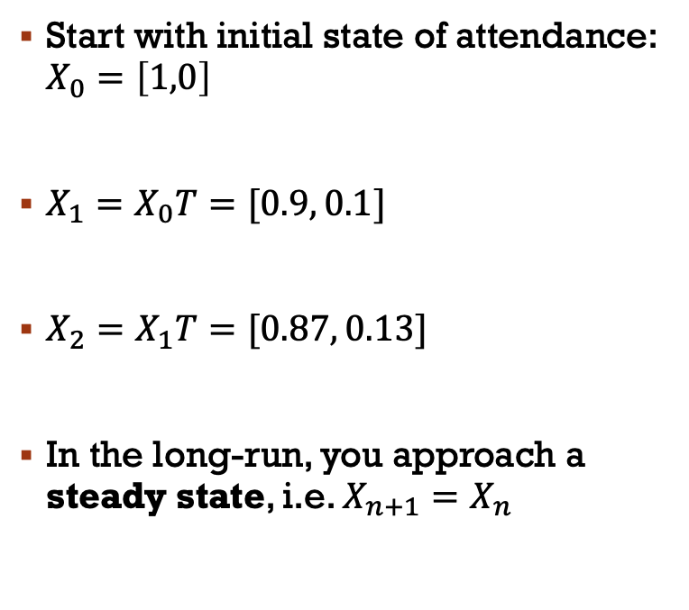
Markov chain properties
0.9
Attend
Start with initial state of attendance: $X_{0}=\left[1,0\right]$
$X_{1}=X_{0}T=[0.9, 0.1]$
$X_{2}=X_{1}T=[0.87, 0.13]$
In the long-run, you approach a steady state, i.e. $X_{n+1}=X_{n}$
0.1
0.6
Skip
0.4
TO
attend
skip
attend
$$\begin{matrix}0.9 & 0.1 \\ 0.6 & 0.4\end{matrix}$$
FROM
skip
Transition matrix

Slide 45
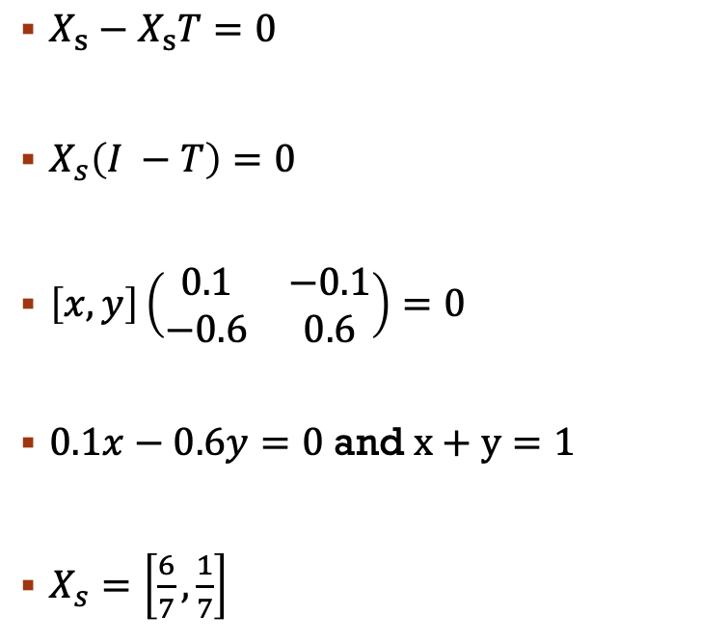
0.9
Markov chain properties
Attend
$X_{s}−X_{s}T=0$
$X_{s}\left(I −T\right)=0$
$\left[x, y\right]\left(\begin{matrix}0.1 & −0.1 \\ −0.6 & 0.6\end{matrix}\right)=0$
$0.1x−0.6y=0$ and $x+y=1$
$X_{s}=\left[\frac{6}{7},\frac{1}{7}\right]$
0.1
0.6
Skip
0.4
TO
attend
skip
attend
$$\begin{matrix}0.9 & 0.1 \\ 0.6 & 0.4\end{matrix}$$
FROM
skip
Transition matrix

Slide 46
Markov chains
Markov chains can also be used to generate a sequence of random variables where the current value is dependent on the value of the prior value
An example of this is a number line, where possible moves are -1 and 1 (chosen with equal probability)
MCMCs are Monte Carlo methods where a Markov chain is used to draw samples
The idea is that the chain will settle (find equilibrium) on the desired quantity we are inferring

Slide 47
Homework (optional)
0.76
Create a class that generates random numbers from a uniform distribution
Create a Markov Chain class that predicts which US party will win the next election (lookup matrices, matrix mutlipliaction, if statements etc.)
Assume initially a Dem is in power X0 = [1,0], create a method in the MC class that calculates numerically the steady state vector, i.e. the probability that in a given year
Create another method that uses random draws from the random number class to stochastically predict who will be in power for each of the next 20 cycles
Create a figure showing how the holder of office changed over the 20 cycles
Democrat
0.24
0.35
Republican
0.65

Slide 48
Your project

Slide 49
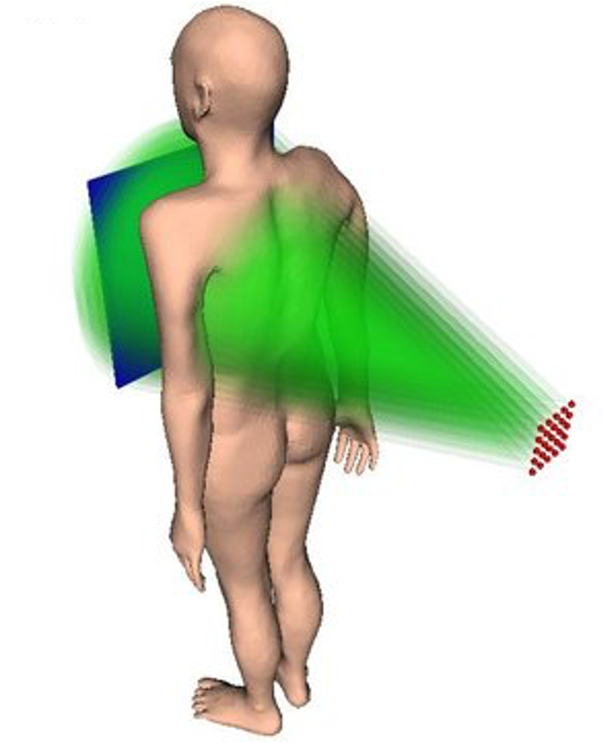
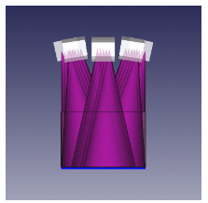
Digital tomosynthesis
We want to minimise radiation leakage in these new devices
Current simulations assume that each beam is emitted according to either a uniform cone, or a truncated Gaussian
Is this fair? Monte Carlo methods can tell us!

Slide 50
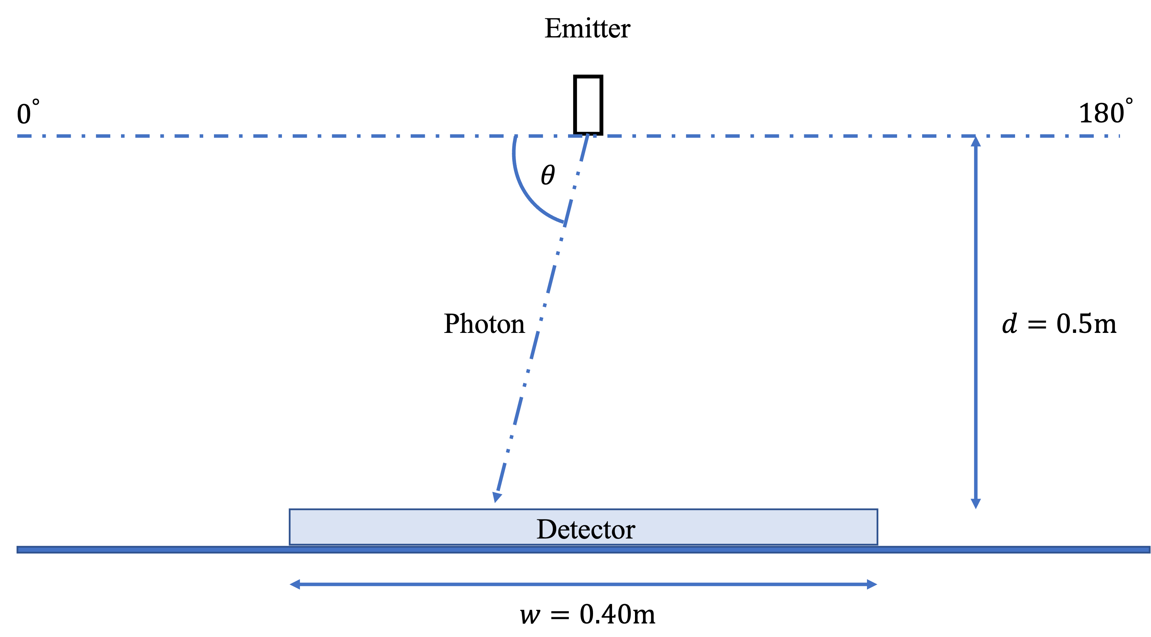
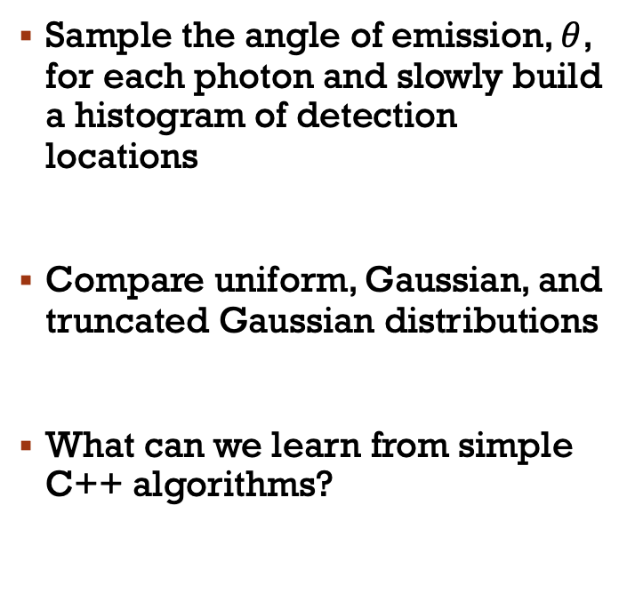
Main problem
Sample the angle of emission, $θ$, for each photon and slowly build a histogram of detection locations
Compare uniform, Gaussian, and truncated Gaussian distributions
What can we learn from simple C++ algorithms?

Slide 51
Project description
A full project description can be found at https://alex-hill94.github.io/Workshop/Intro_to_C++/project_description.pdf
Separate into two groups to complete this task, I suggest:
Team one: Lauryn, Alex, Ryan, Andrew, Rob
Team A: Katie, Jonah, Ali, Tom, Andrea
We’ll work on this today, next week, and have a short presentation in the new year
Create a slack channel for your group to communicate

Slide 52
Next week
Group work

Slide 53
Thanks!

